Slide 1


Sample questions

Slide 2

Neural language models [3 Marks]
Study the below neural network designed for learning word embedding along with other NLP applications and answer the following questions.

Slide 3
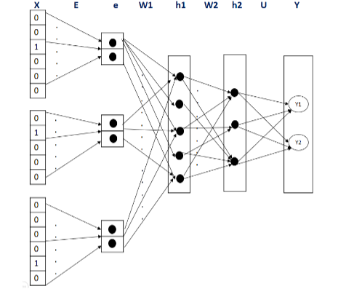

















Slide 4


If the input layer ‘X’ denote the one hot encoding of the vocabulary, “e” is the embedding layer,
“h1”,”h2” are hidden layers with sigmoid activation function and “Y” is the output layer with
sigmoid activation function, identify no more than 2 issues/error in the architecture for each of the
below two scenarios: If there are no corrections required then mention “No Error” explicitly.
a) Scenario 1: The input with context window of four tokens is used to predict the next fifth token. The candidate fifth word can be either Y= “.” Or Y=”?” for this application.
b) Scenario 2: Top three frequent tokens with embedding of size three, is used to predict the
sentiment from the set {Positive, Negative, Neutral} of the document from where the tokens were
extracted.
c) With respect to the “scenario 1”, find the dimension (matrix size) w.r.t to section/layer “W1” and
“U”

Slide 5
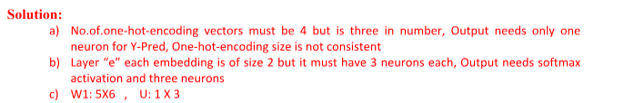

Slide 6









2. “Erring is human. To err is human. Seeing is believing. To see is to believe.”
For the given above training data construct a neural architecture for language modelling for the following
case. Mention the dimension at each and every layer and for the weights between layers.
Case: “Using context window of size 4, design a neural network to predict the next word with candidate
vocabulary of size 10. Each vocabulary has a word embedding of dimension 3. Use two internal hidden
layers. First one with 6 neurons and second with 4 neurons. Each internal hidden layers must be use sigmoid activation function. “
If the above needs to be changed to accommodate the net to learn the word embedding as well, do the
necessary modification in above case study requirement and pictorially draw the final network (No need to
draw all the connection between immediate layers).

Slide 7
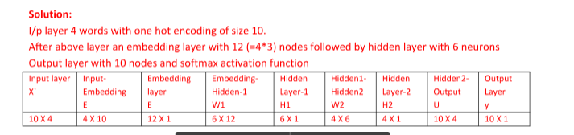

Slide 8
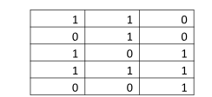
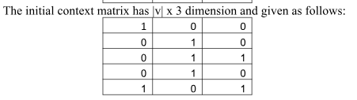
Given a training corpus: “I live in Bangalore, India”, use the skip-gram negative sampling method and answer the following: The initial embedding matrix has dimensions |v| x 3 and is given as follows:
a) Generate the training dataset for an input word ‘I” and context window of 1 next word and
hyper parameter value k=3 for the negative sampling task. Use the information available in
the question.
b) Calculate the error for the above dataset during the first iteration of skip-gram training.

Slide 9
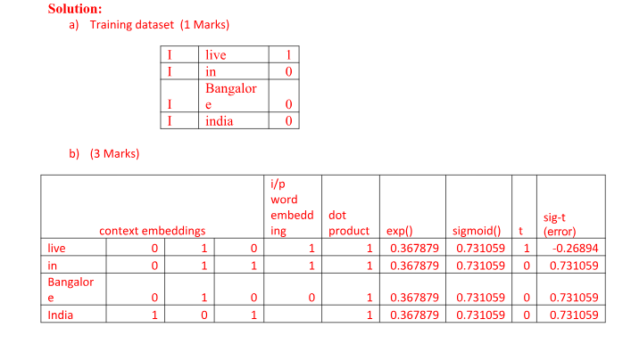

Slide 10
Given a training corpus: “played in the morning”, use the skip-gram negative sampling method and answer the following: The initial embedding matrix and initial context matrix has dimensions |v| x 3 and is given as follows: Note: No need to update or show any weights other than necessary for below questions. Follow only the approach as discussed in class. i.e., Simplified Skip gram negative sampling with binary classification model. Round all the calculations to exactly two decimal places. a) Generate the training dataset for an input target word “played” and context window of 1 next word and hyper parameter value k=2 for the negative sampling task. Use the information available in the question. b) Calculate the error for the above dataset for only the first iteration of skip-gram training, with only one hidden layer.

Slide 11
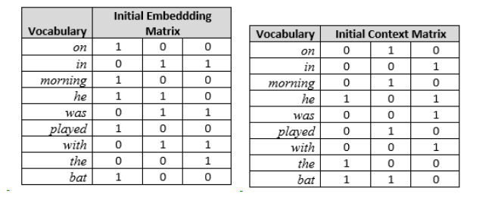

Slide 12
